Slide 1



PROJECT REPORT
Presented by : Yusra Sayed

Slide 2
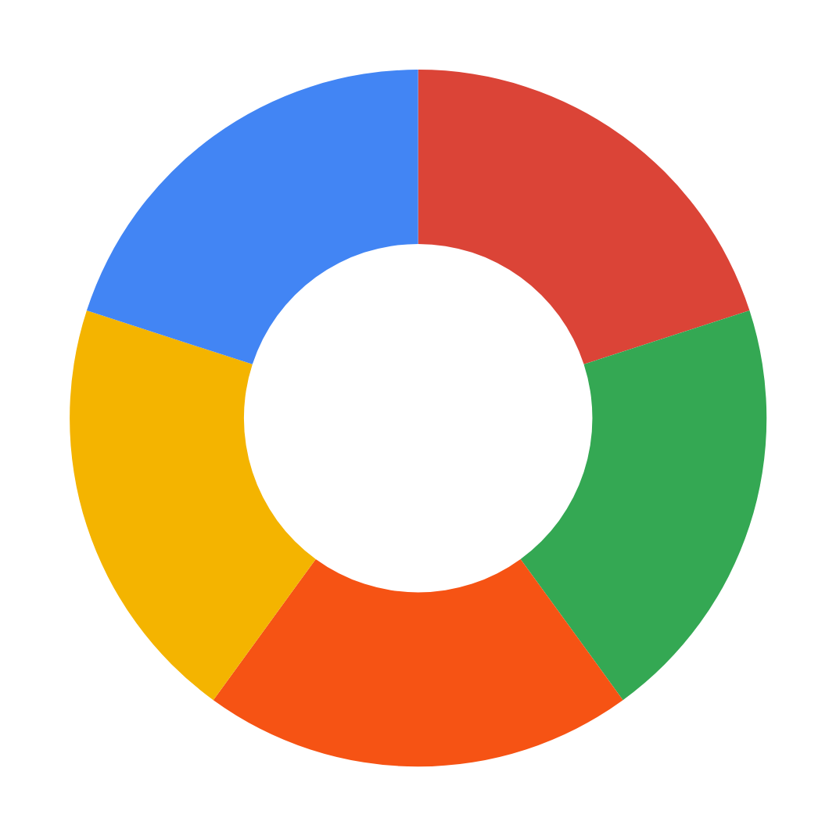

PROBLEM STATEMENT
Understand reason for app success
Deep
Analysis
The goal is to analyze the Google Play Store Apps dataset to derive insights into the app market.
We aim to understand the factors that contribute to an app's success, including its user ratings, reviews, and category.
We want to explore user sentiments towards apps by analyzing the user reviews dataset. Additionally, we can see insights into the popularity of app categories based on the total number of installs and the sentiment polarity of user reviews.
AIM
Explore
user
sentiments
Sentiment
Polarity
Impact
Provide recommendations for app developers

Slide 3
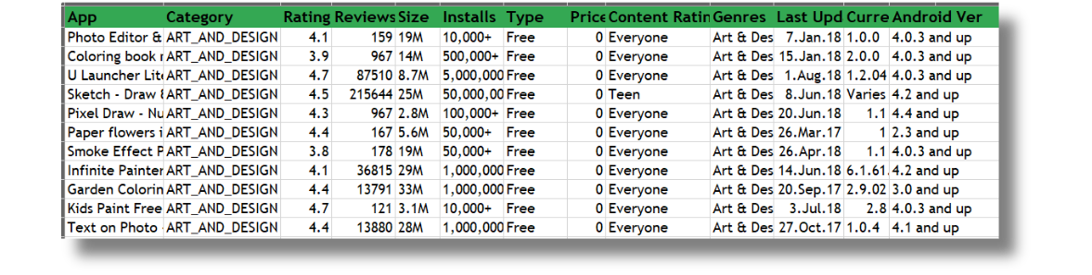
ABOUT THE DATASET
googleplaystore
App Category
Rating
Reviews
Size
Installs
Type
Price
Content Rating
Genres
Last Updated
Current Ver
Android Ver

Slide 4
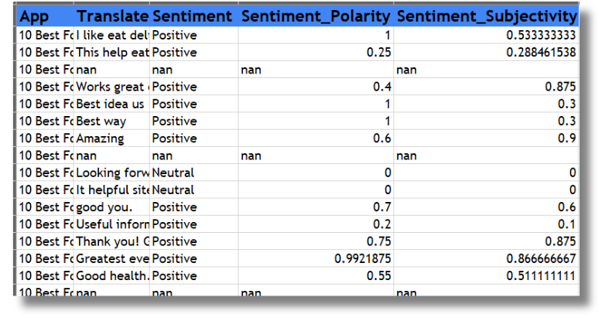
user_reviews
App
Translated_Review
Sentiment
Sentiment_Polarity
Sentiment_Subjectivity

Slide 5

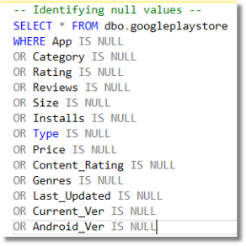
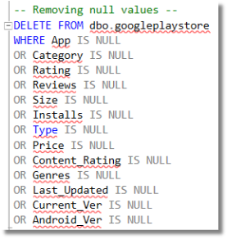
SQL QUERIES
Identifying NULL Values
Removing NULL Values

Slide 6

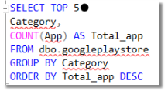
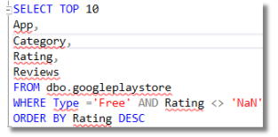
Overall view of dataset
Exploring app cateogries
Top rated free apps

Slide 7
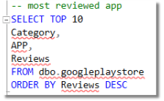
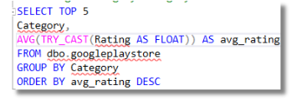
Most reviewed apps
Average rating by category

Slide 8
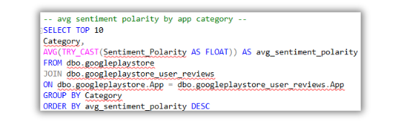
JOIN QUERIES
This SQL query calculates the average sentiment polarity for apps grouped by their category.
It joins two tables, googleplaystore and googleplaystore_user_reviews, using the app name as the key.
The query selects the top 10 categories with the highest average sentiment polarity, ordering the results in descending order.

Slide 9
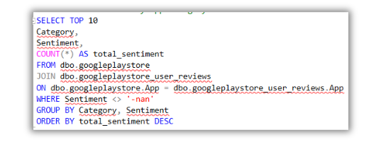
JOIN QUERIES
This SQL query retrieves the top 10 categories and their corresponding sentiment counts from user reviews, excluding those with a sentiment value of '-nan'.
It counts the total number of reviews for each sentiment within each category, groups the results by category and sentiment, and orders them by the highest total sentiment count in descending order.

Slide 10
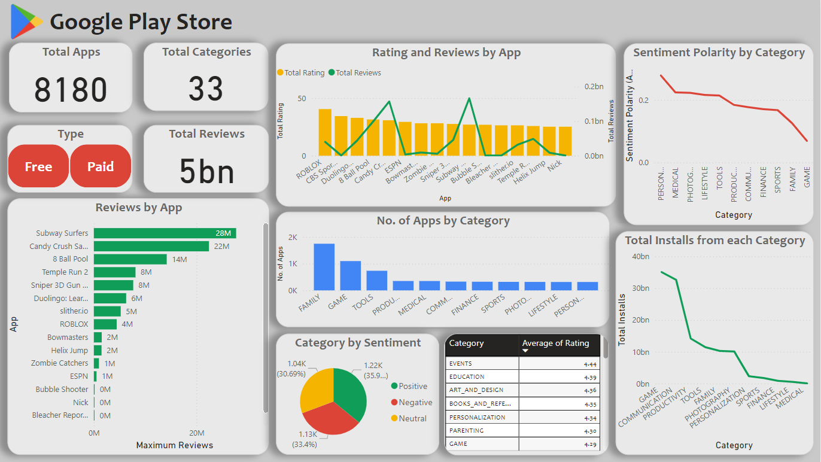
DASHBOARD

Slide 11

THANK YOU

